Slide 1




Internship on AI & ML

Slide 2
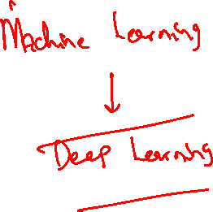
Machine Learning Projects

Slide 3
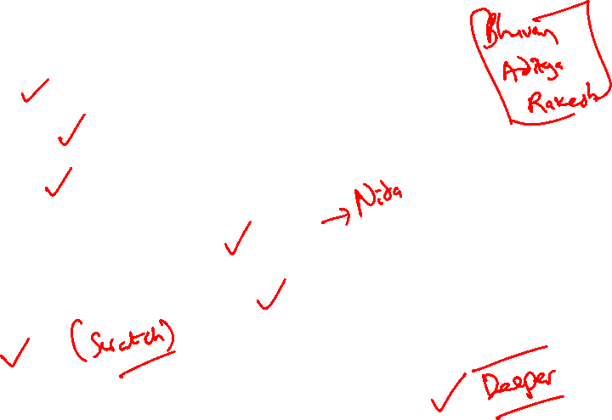
Hands-On Projects
Regression
Classification
Clustering
Association Rule Mining
Dimensionality Reduction
ANNs
Deep Learning (CNNs, RNNs, NLP etc)

Slide 4
Day 1 : Mon 06-09-2021
Contents:
General Introduction
Overview of ML
ML Application use cases

Slide 5
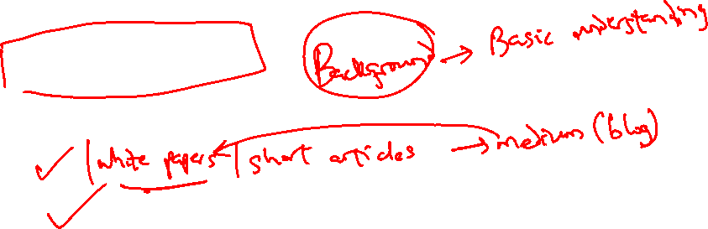
Source Materials
R. Duda, P. Hart & D. Stork, Pattern Classification (2nd ed.), Wiley (Required)
T. Mitchell, Machine Learning, McGraw-Hill (Recommended)
Papers/blogs
Video lectures

Slide 6
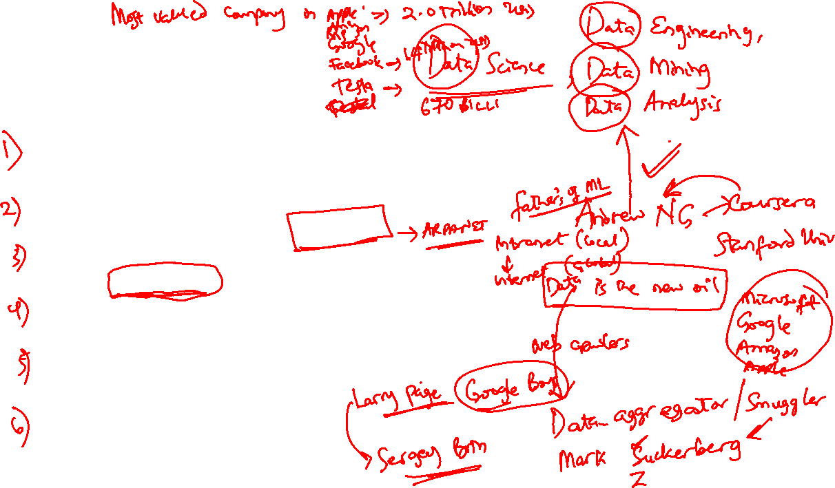
A Few Quotes
“A breakthrough in machine learning would be worth ten Microsofts” (Bill Gates, Chairman, Microsoft)
“Machine learning is the next Internet” (Tony Tether, Director, DARPA)
Machine learning is the hot new thing” (John Hennessy, President, Stanford)
“Web rankings today are mostly a matter of machine learning” (Prabhakar Raghavan, Dir. Research, Yahoo)
“Machine learning is going to result in a real revolution” (Greg Papadopoulos, CTO, Sun)
“Machine learning is today’s discontinuity” (Jerry Yang, CEO, Yahoo)

Slide 7
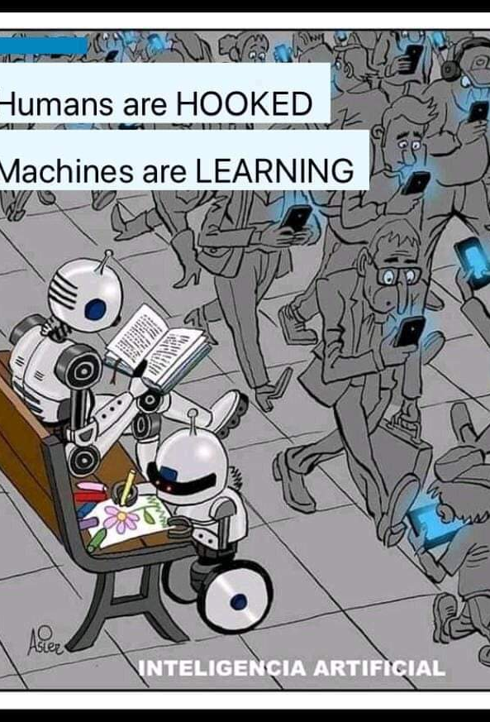
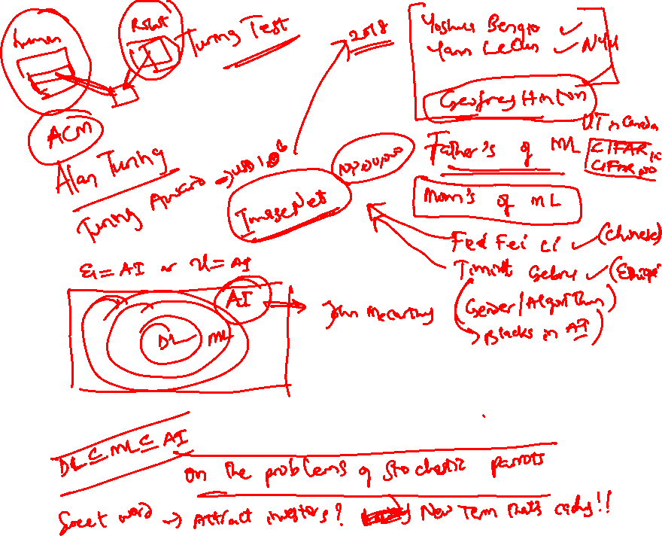
So What Is Machine Learning?
Automating automation
Getting computers to program themselves
Writing software is the bottleneck
Let the data do the work instead!

Slide 8
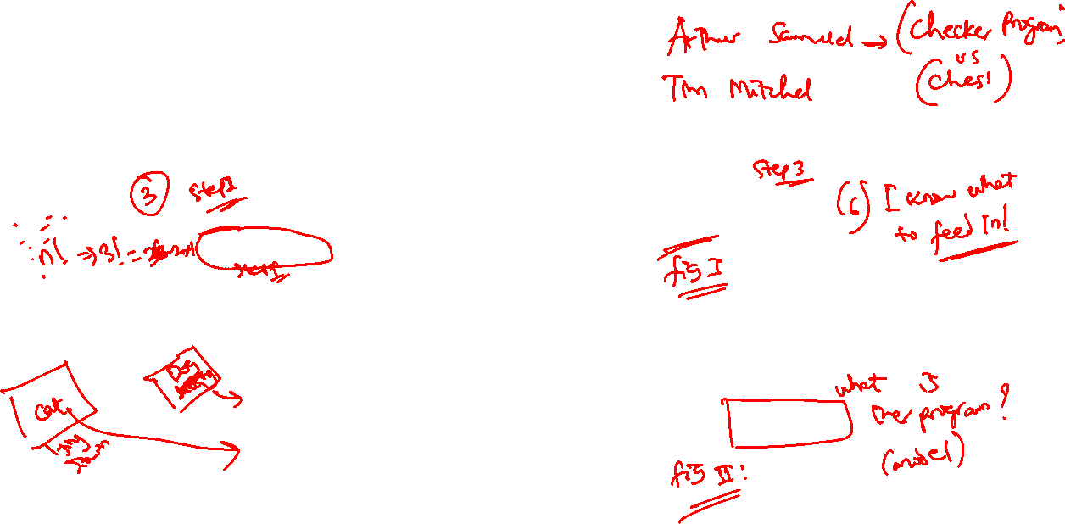
Traditional VS ML Programming
Traditional Programming
Machine Learning
Computer
Data
Output
Program
Computer
Data
Program
Output

Slide 9
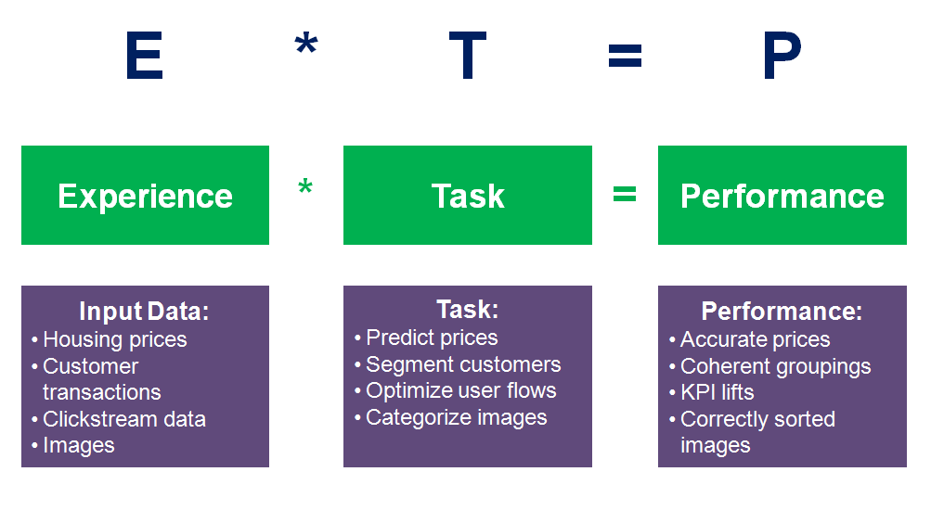
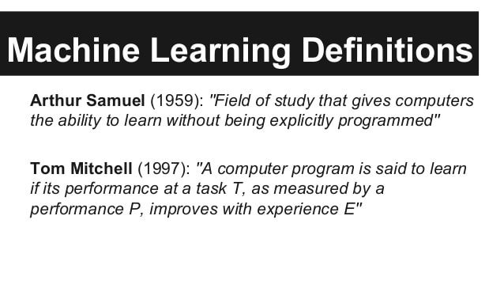
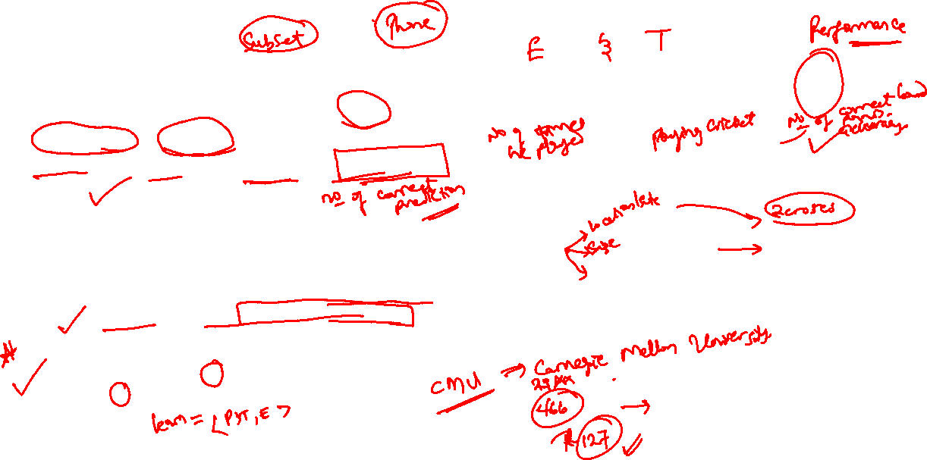
So, what is Machine Learning?
Machine learning is a branch of artificial intelligence (AI) and computer science which focuses on the use of data and algorithms to imitate the way that humans learn, gradually improving its accuracy. (IBM)

Slide 10


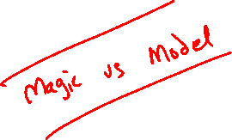
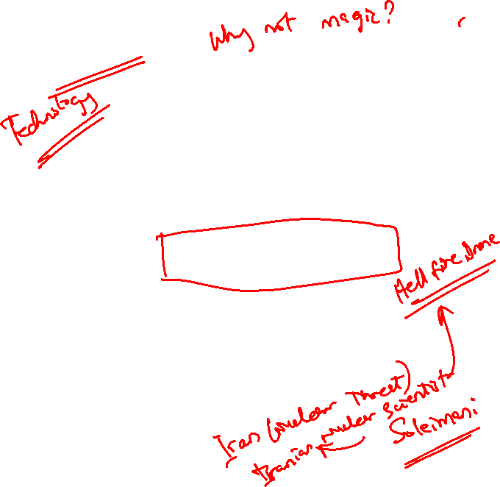
Magic?
No, more like gardening
Seeds = Algorithms
Nutrients = Data
Gardener = You
Plants = Programs

Slide 11
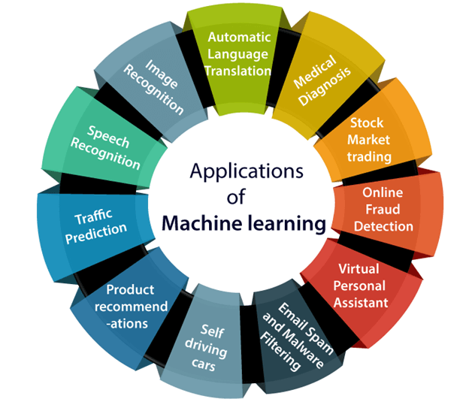

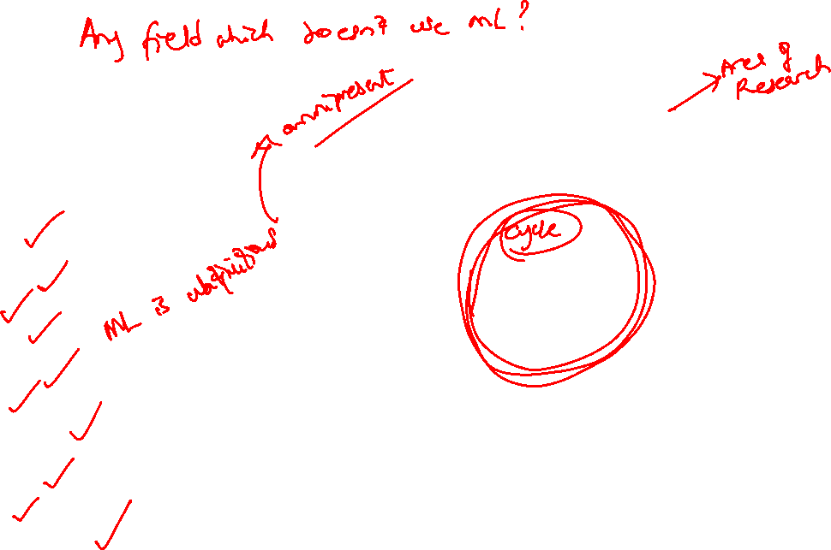
Sample Applications
Web search
Computational biology
Finance
E-commerce
Space exploration
Robotics
Information extraction
Social networks
Debugging
[Your favorite area]

Slide 12
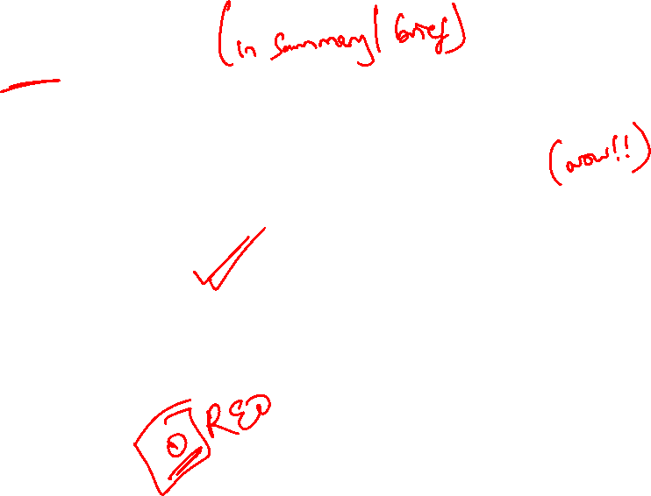
ML in a Nutshell
Tens of thousands of machine learning algorithms
Hundreds new every year
Every machine learning algorithm has three components:
Representation
Evaluation
Optimization

Slide 13
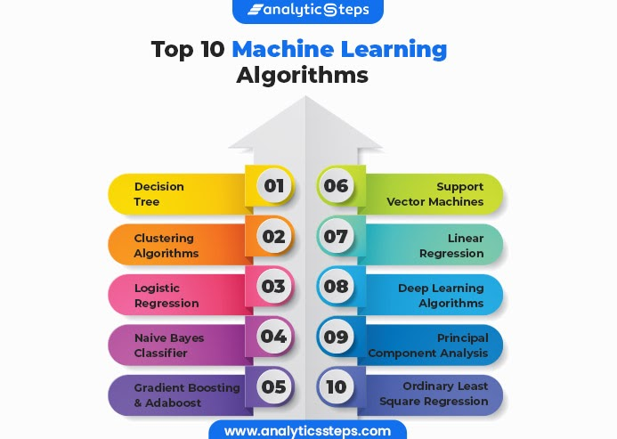


Slide 14
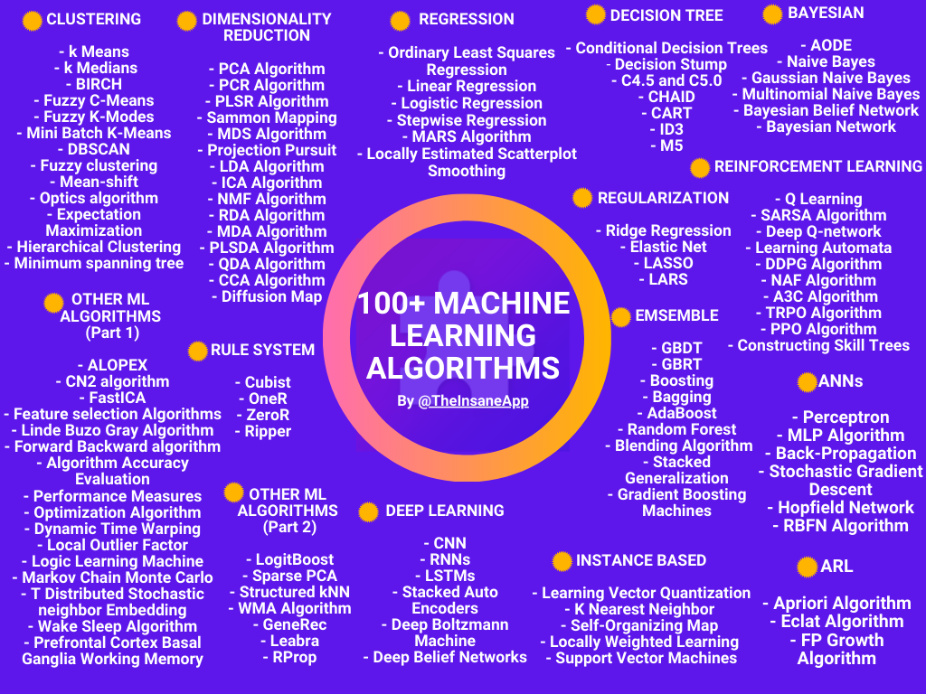

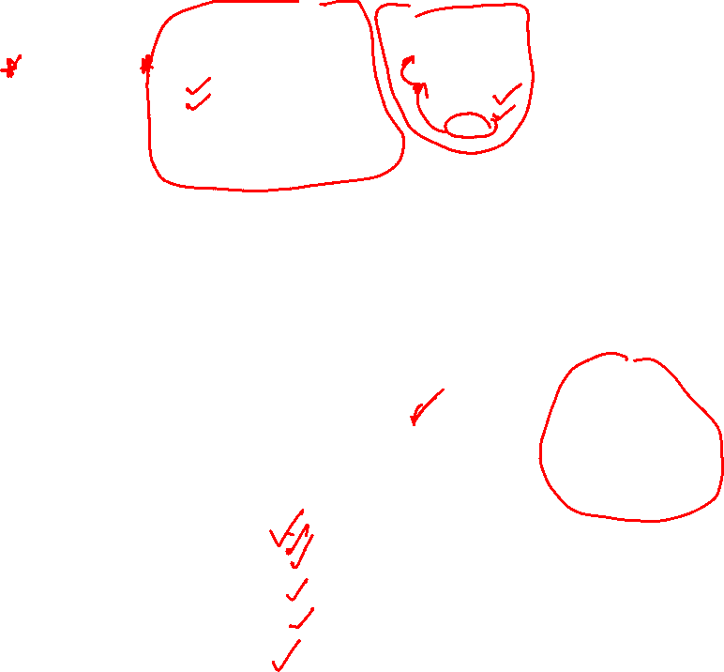
Regression

Slide 15
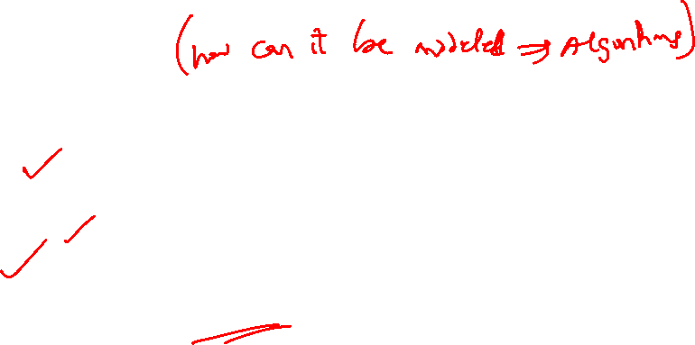
Representation
Decision trees
Sets of rules / Logic programs
Instances
Graphical models (Bayes/Markov nets)
Neural networks
Support vector machines
Model ensembles
Etc.

Slide 16
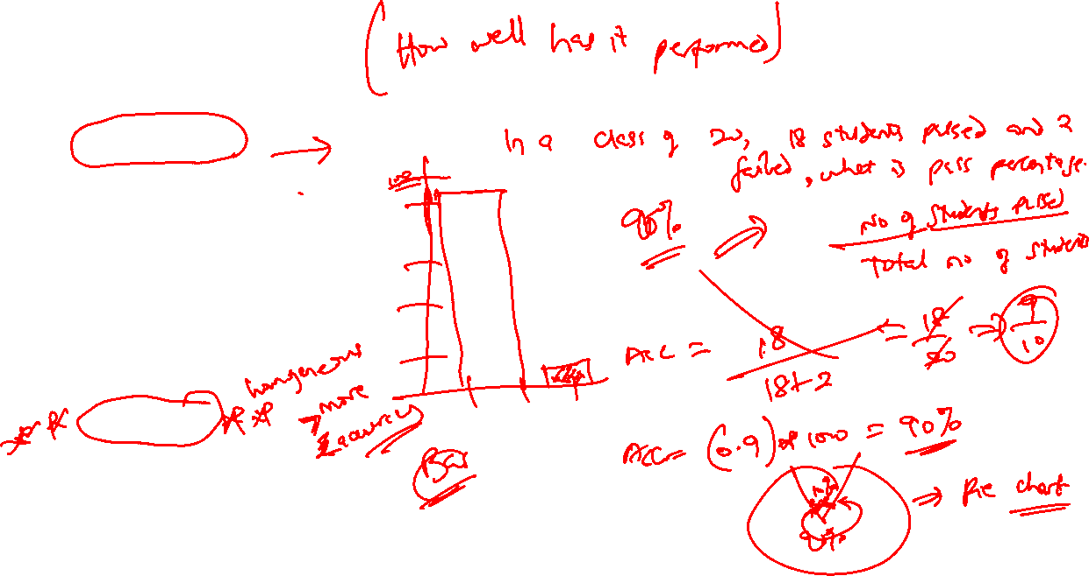
Evaluation
Accuracy
Precision and recall
Squared error
Likelihood
Posterior probability
Cost / Utility
Margin
Entropy
K-L divergence
Etc.

Slide 17
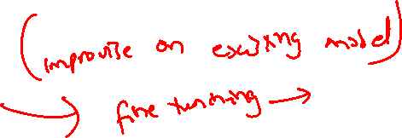
Optimization
Combinatorial optimization
E.g.: Greedy search
Convex optimization
E.g.: Gradient descent
Constrained optimization
E.g.: Linear programming

Slide 18
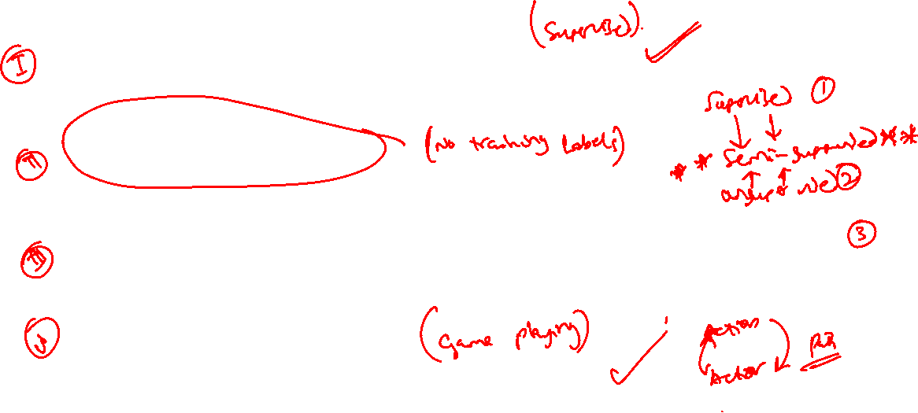
Types of Learning
Supervised (inductive) learning
Training data includes desired outputs
Unsupervised learning
Training data does not include desired outputs
Semi-supervised learning
Training data includes a few desired outputs
Reinforcement learning
Rewards from sequence of actions

Slide 19
Inductive Learning
Given examples of a function (X, F(X))
Predict function F(X) for new examples X
Discrete F(X): Classification
Continuous F(X): Regression
F(X) = Probability(X): Probability estimation

Slide 20
What We’ll Cover
Supervised learning
Decision tree induction
Rule induction
Instance-based learning
Bayesian learning
Neural networks
Support vector machines
Model ensembles
Learning theory
Unsupervised learning
Clustering
Dimensionality reduction

Slide 21
ML in Practice
Understanding domain, prior knowledge, and goals
Data integration, selection, cleaning, pre-processing, etc.
Learning models
Interpreting results
Consolidating and deploying discovered knowledge
Loop

Slide 22
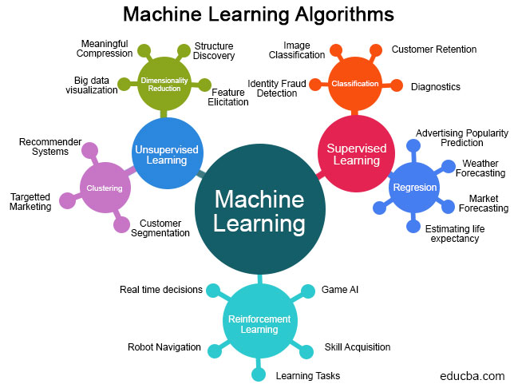
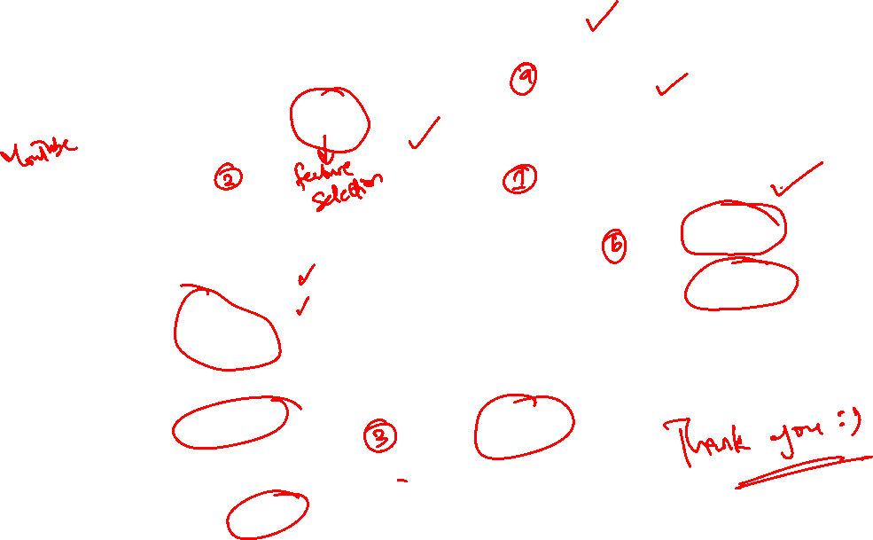

Slide 23
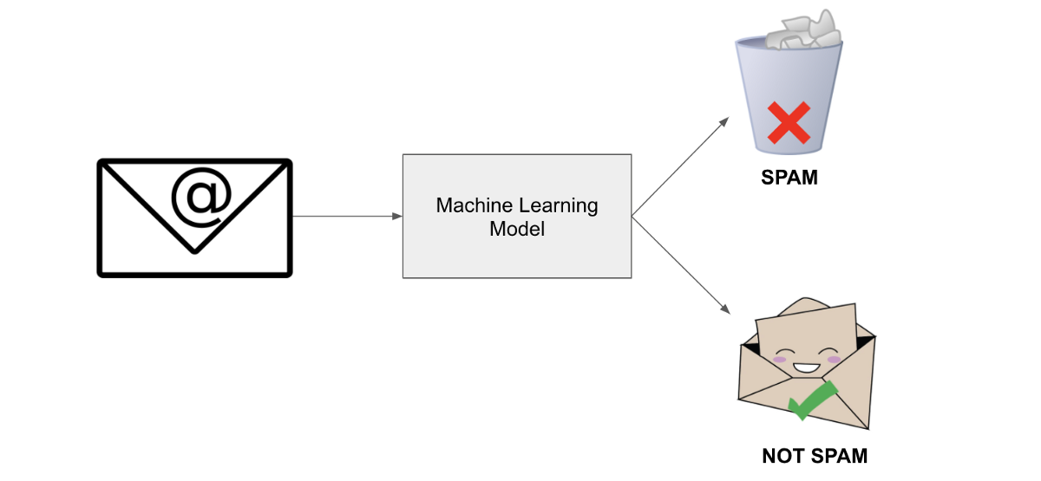
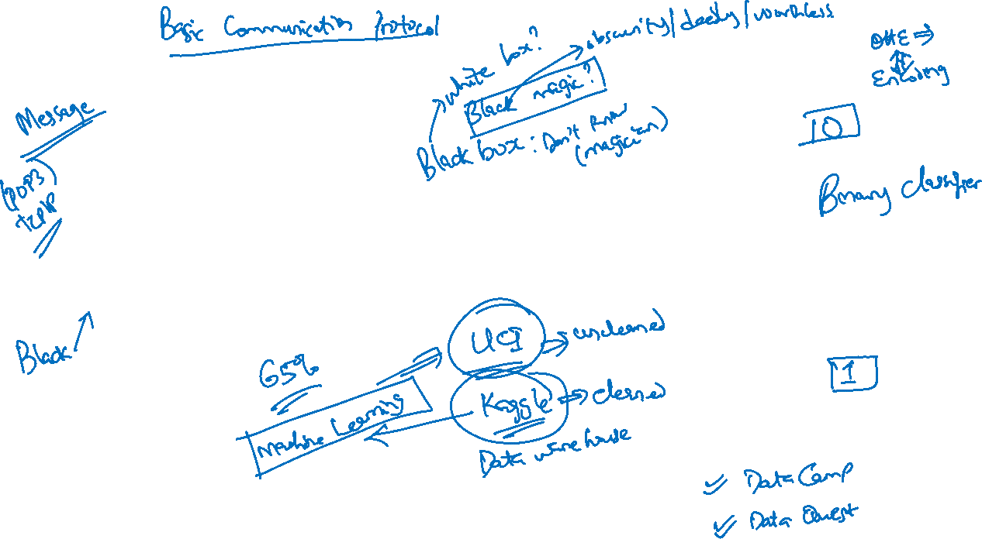
Classification

Slide 24
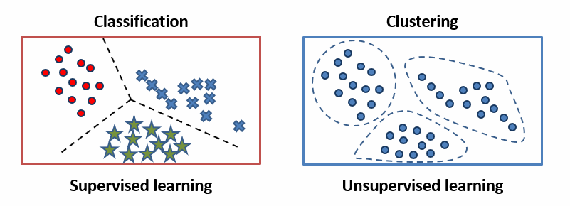
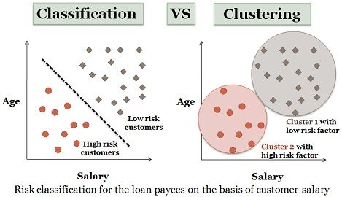
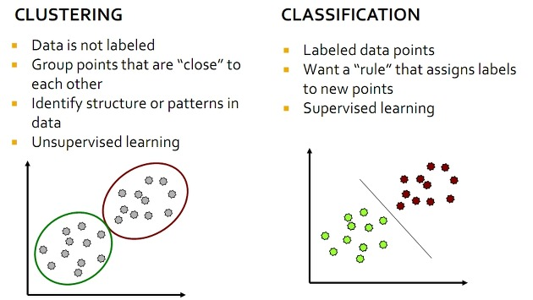
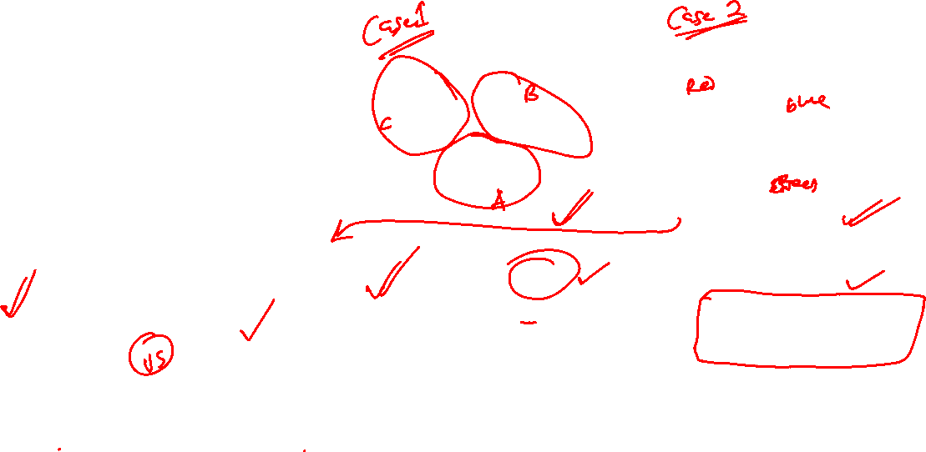
Classification vs. Clustering

Slide 25
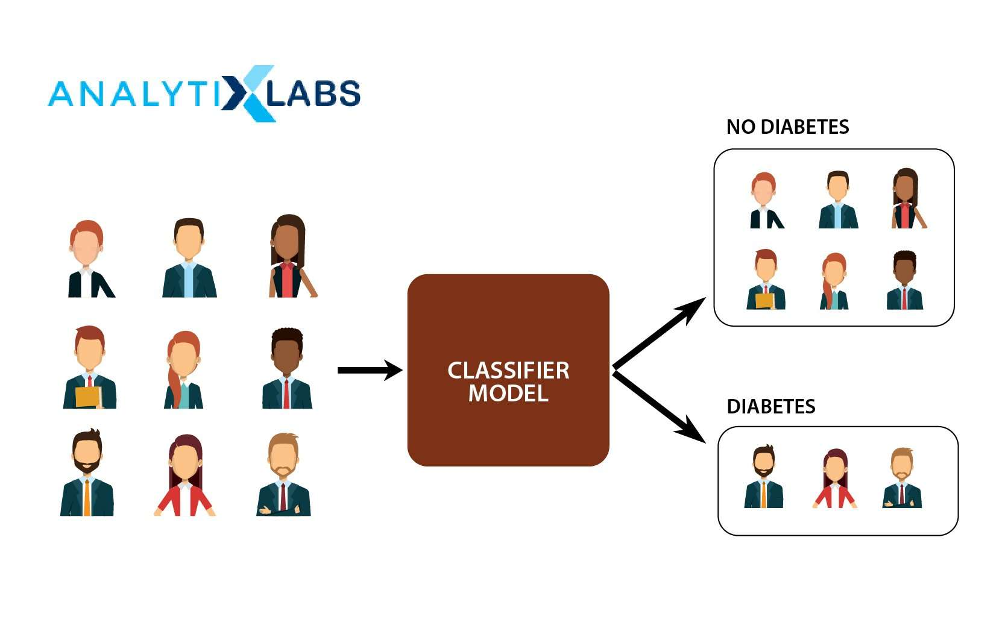


Slide 26
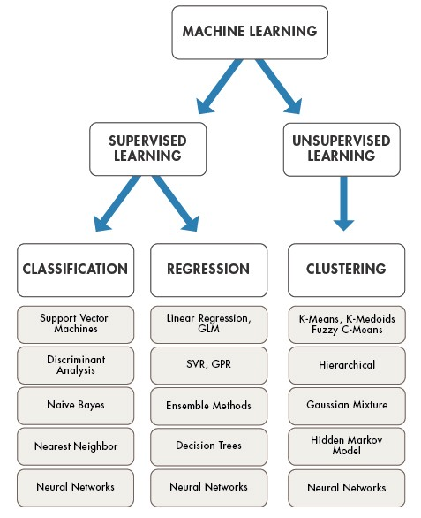
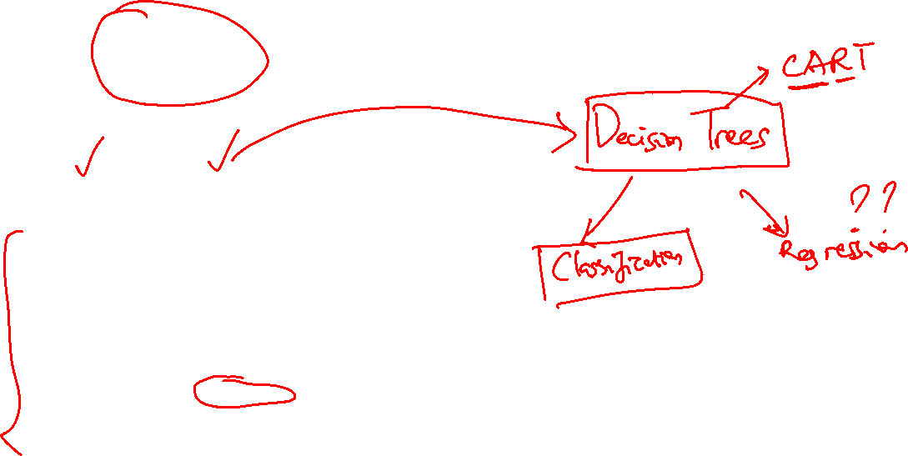

Slide 27

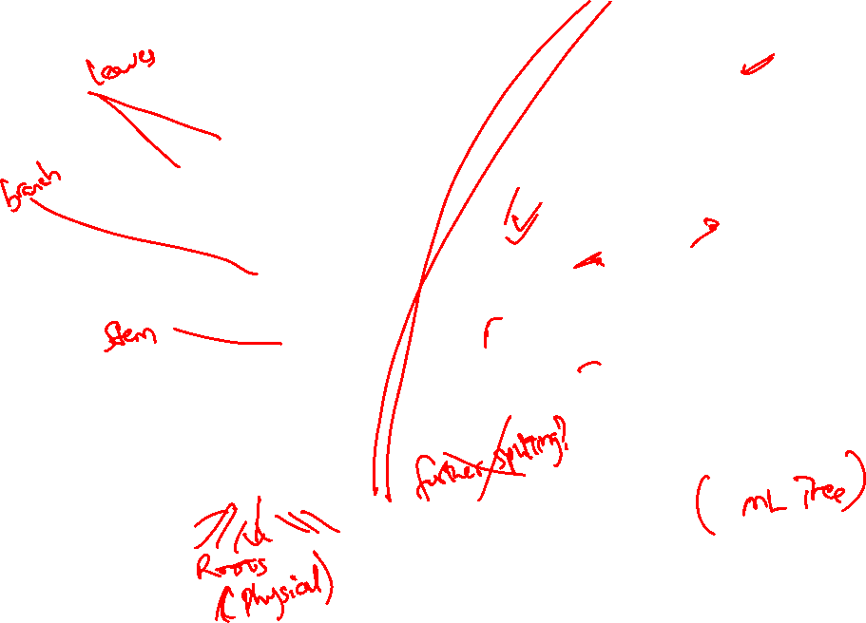
Classification: Decision Trees

Slide 28
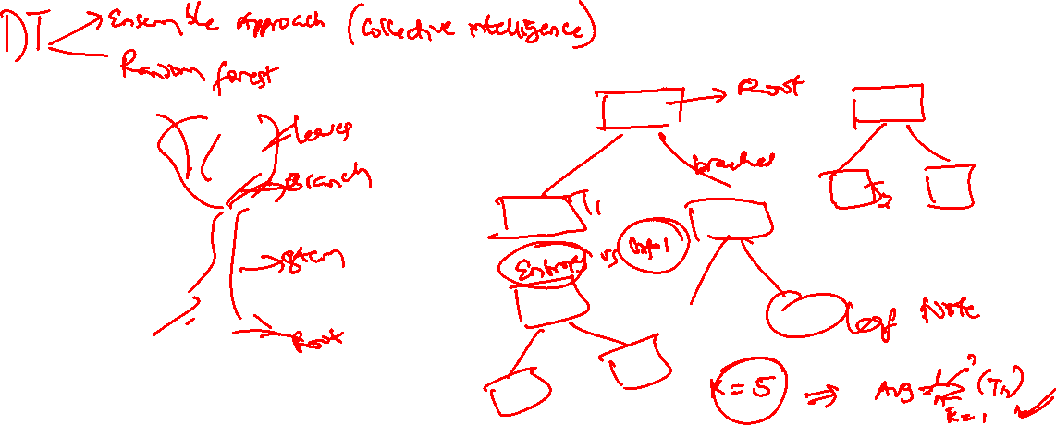
DT: Now Switch Slides

Slide 29
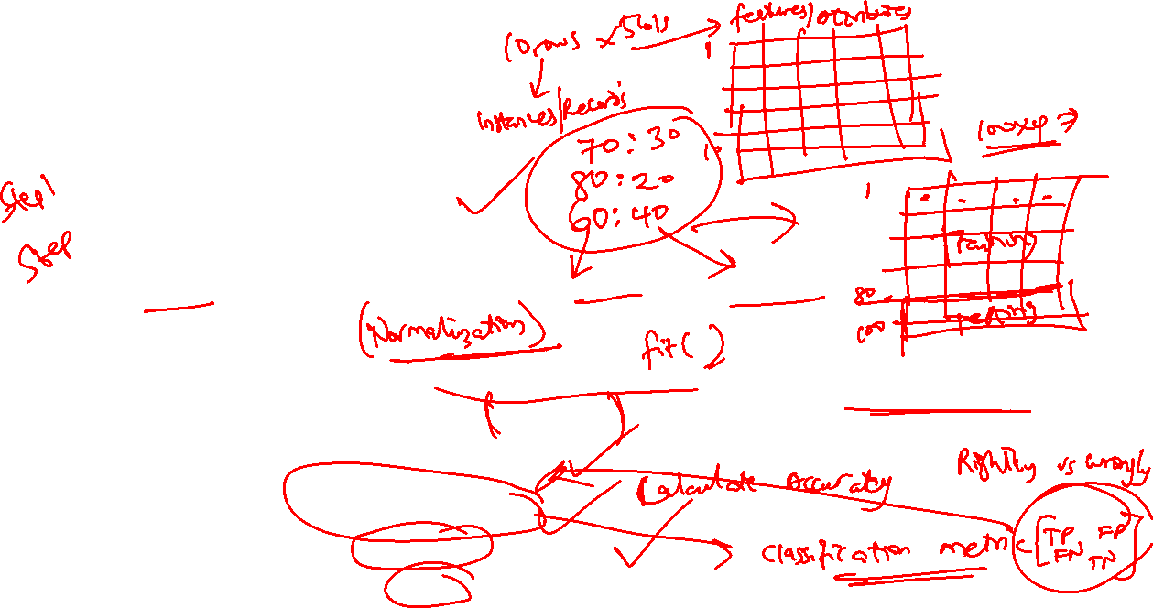

DT STEPS
1 Importing the libraries
2 Importing the dataset
3 Splitting the dataset into the Training set and Test set
4 Feature Scaling
5 Training the Decision Tree Classification model on the Training set
6 Predicting a new result
7 Predicting the Test set results
8 Making the Confusion Matrix
9 Visualising the Training set results
10 Visualising the Test set results

Slide 30
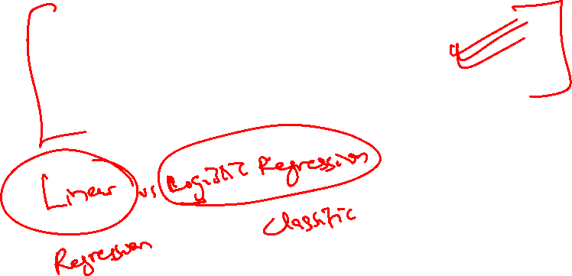
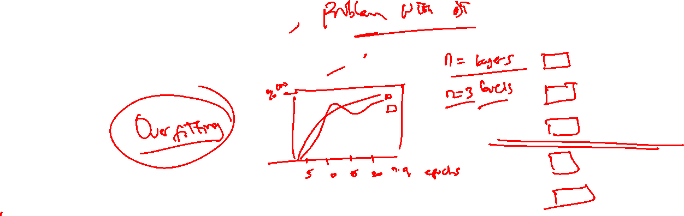
Random Forests

Slide 31
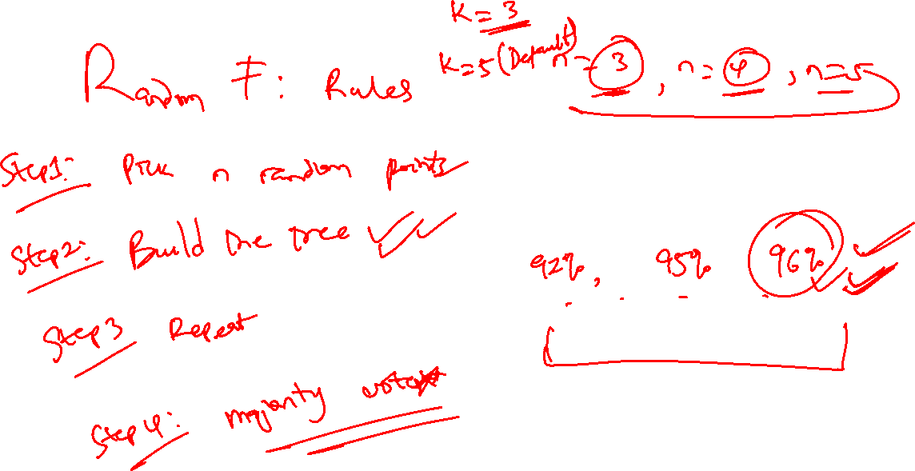

Slide 32
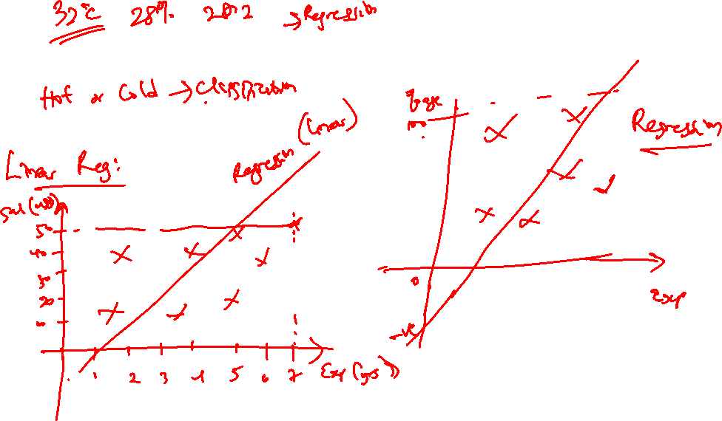

Slide 33
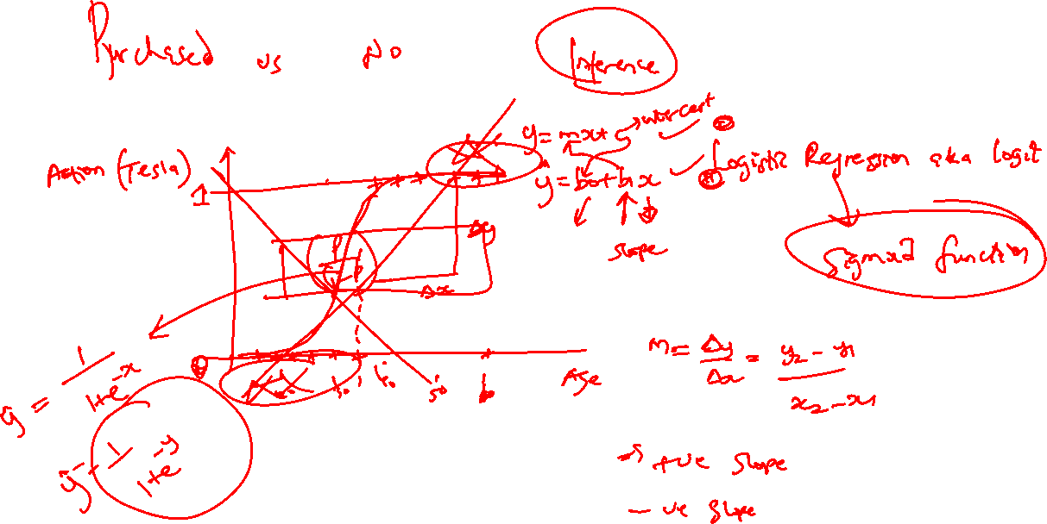

Slide 34
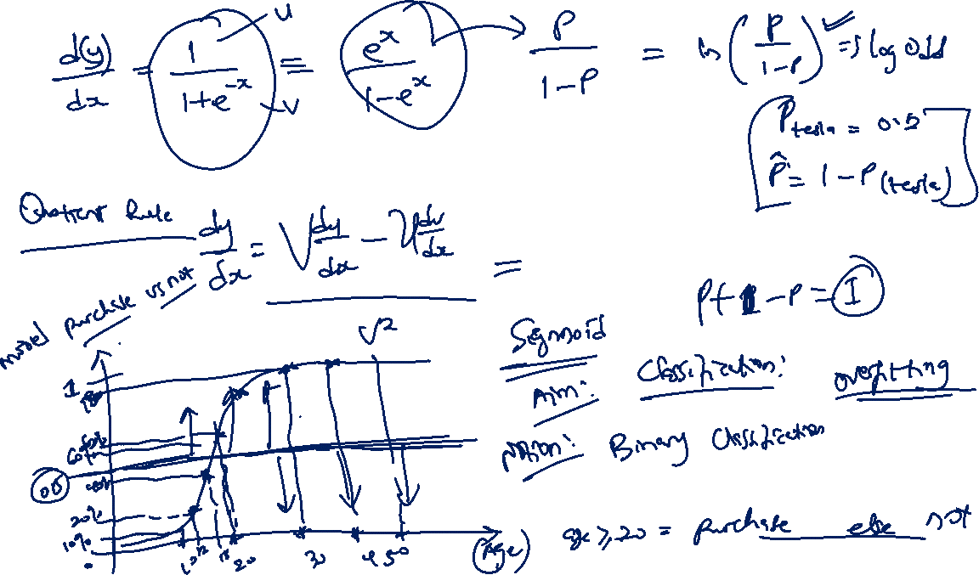

Slide 39
Logistic Regression

Slide 40
KNN

Slide 41
SVM

Slide 42
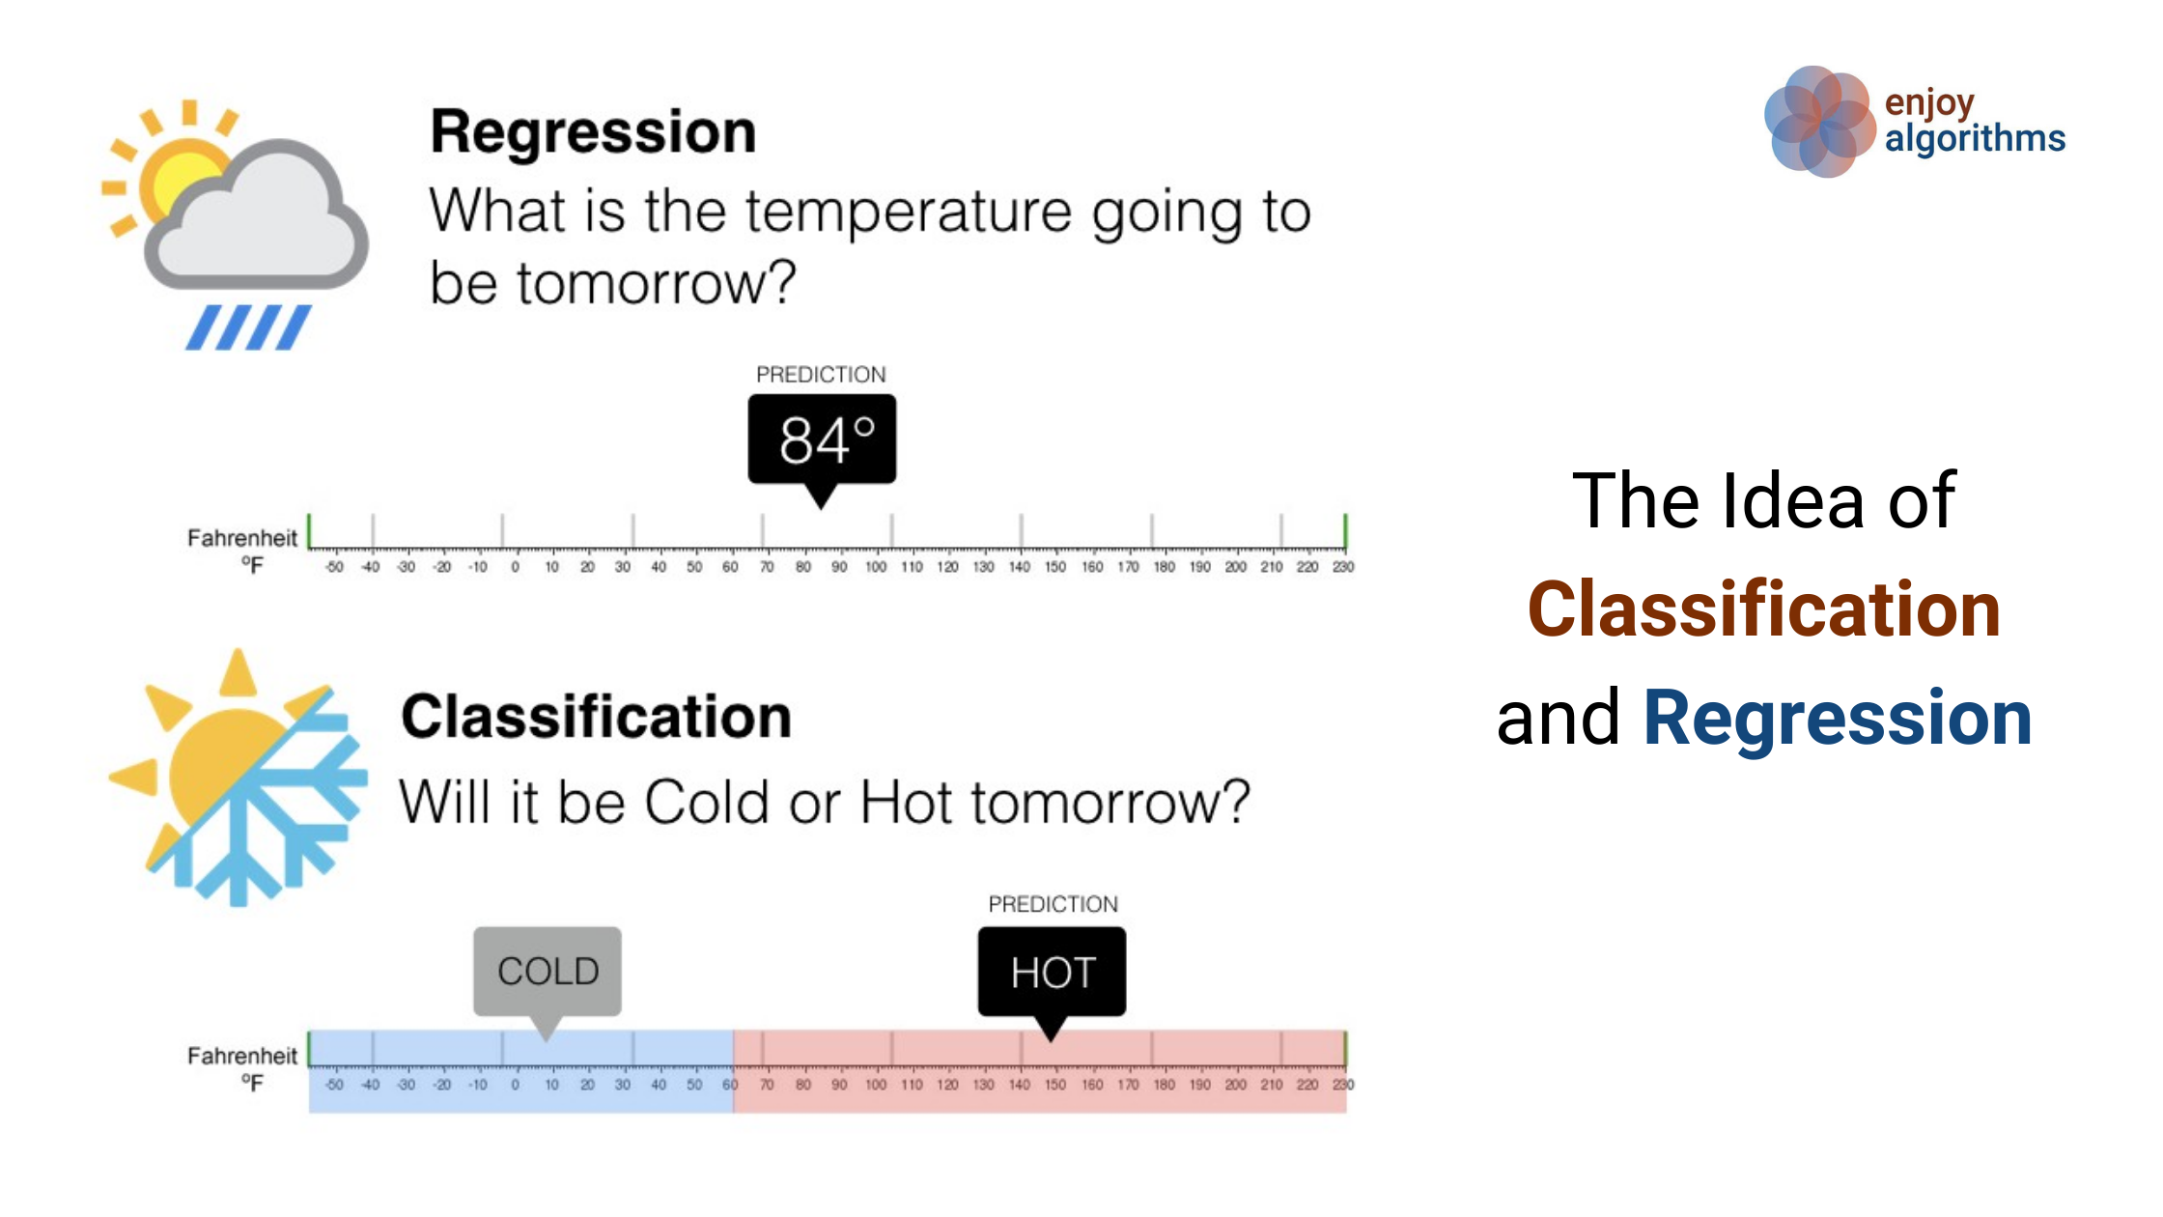

Slide 43
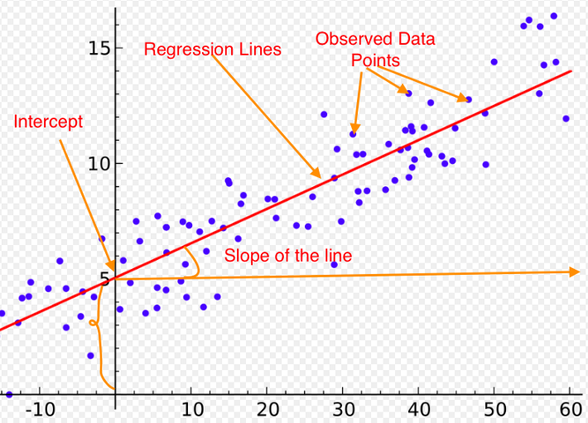
Regression

Slide 44
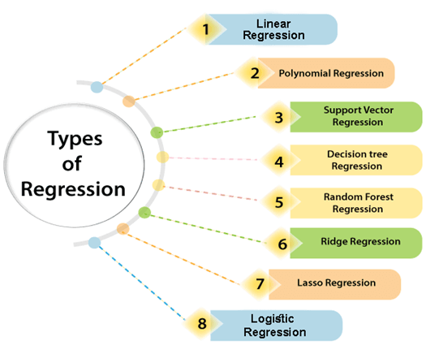
Regression Types

Slide 45
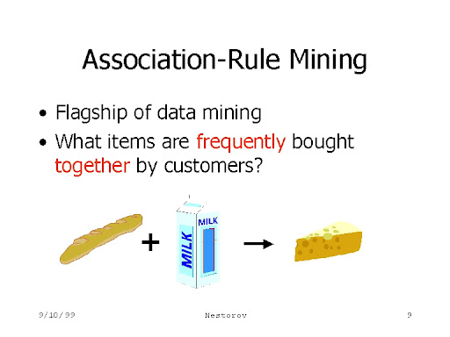
Association Rule Mining

Slide 47
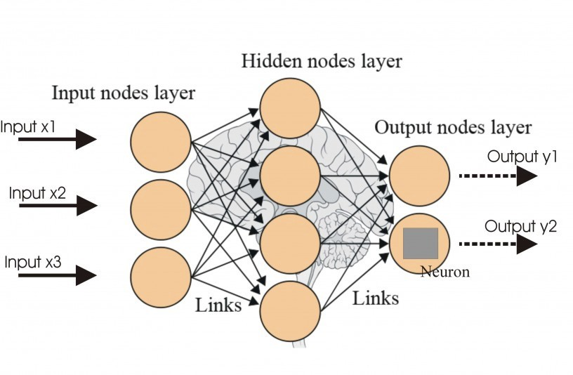
ANN (Maths vs Myths)

Slide 48
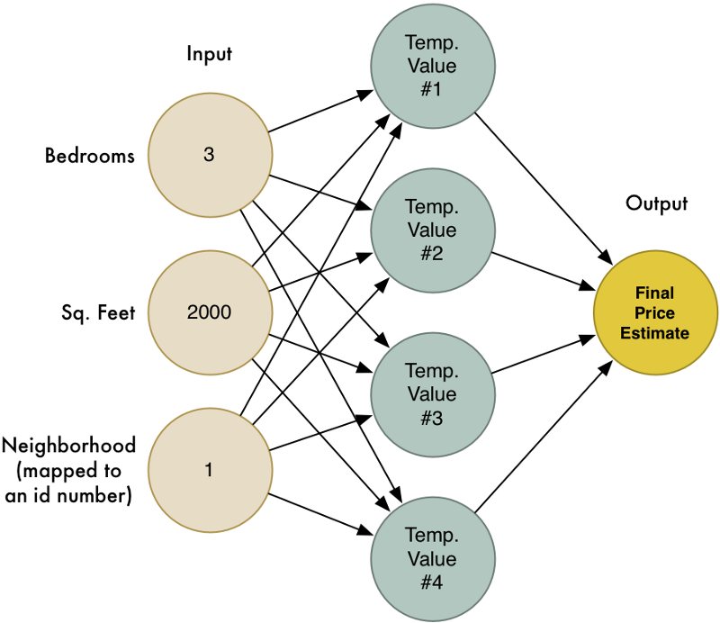
ANN (An Example)

Slide 49


